Slide 1


CS-482: Introduction to BlockChain and CryptoCurrency
Lecture # 1: Cryptography and Technical Foundation
Prof. Dr. Sufian Hameed
Department of Computer Science
FAST-NUCES
FAST-NUCES
Notes:
<number>

Slide 2
Overview
Cryptographic Hash Functions
Public Key Crypto
RSA vs ECC
Digital Signatures
Hash Pointers
Merkle Trees
Block Structure and Chains
FAST-NUCES

Slide 3
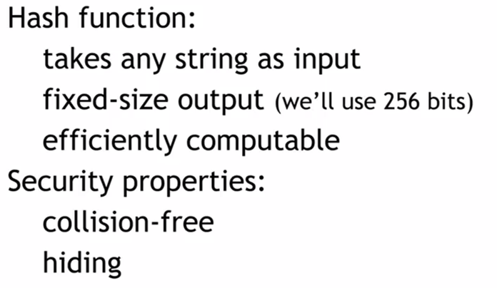
FAST-NUCES

Slide 4
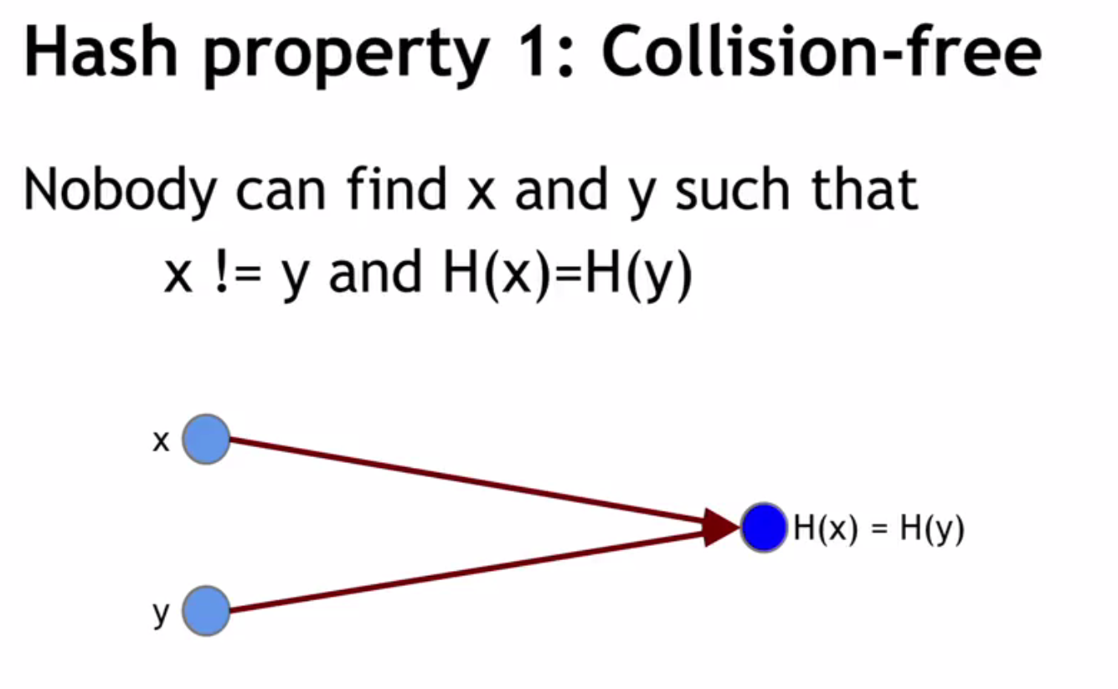
FAST-NUCES

Slide 5
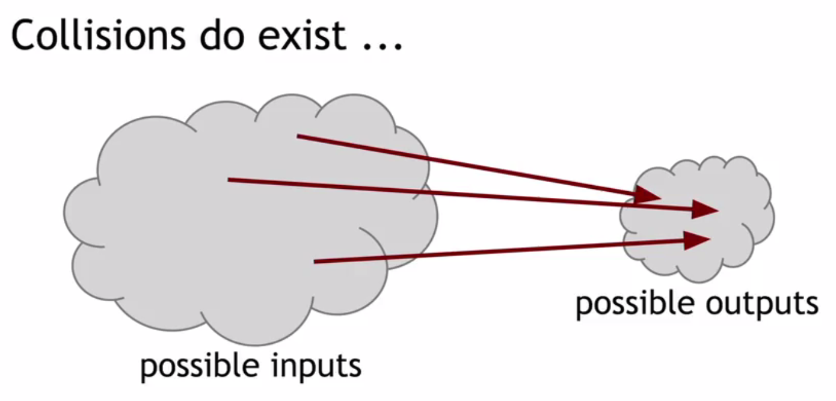
FAST-NUCES

Slide 6
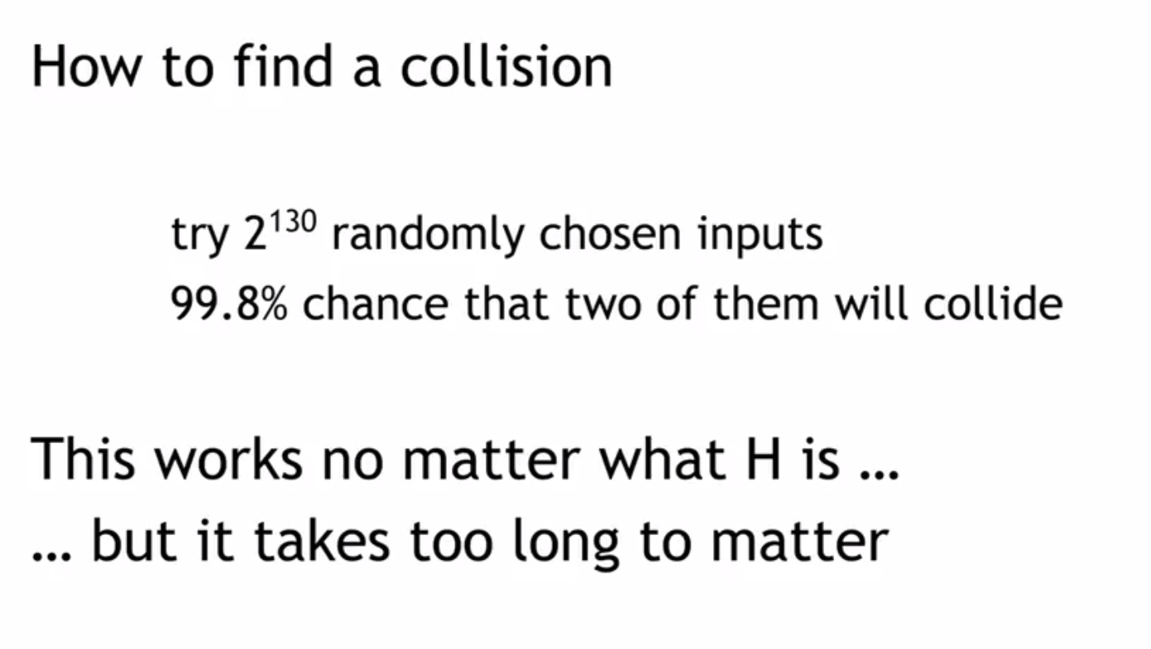
FAST-NUCES

Slide 7
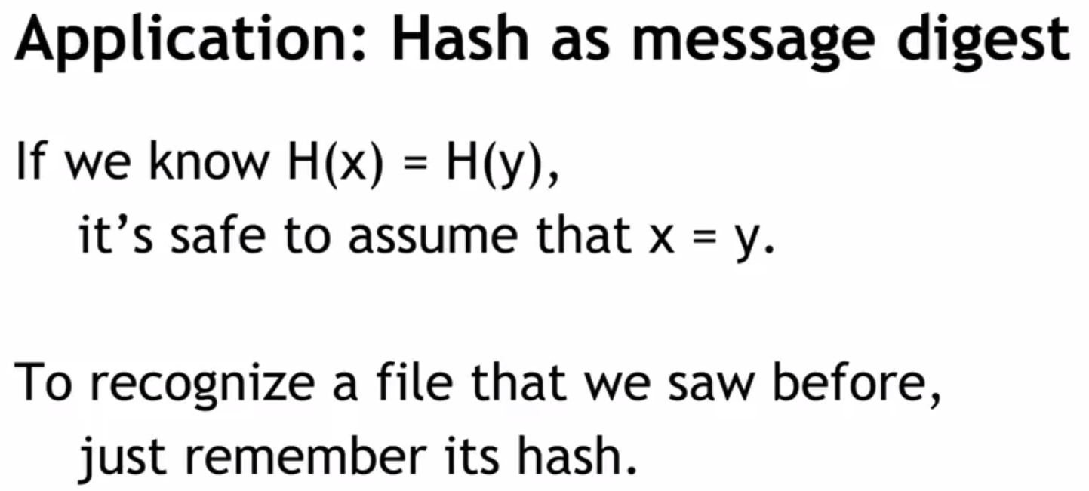
FAST-NUCES

Slide 8
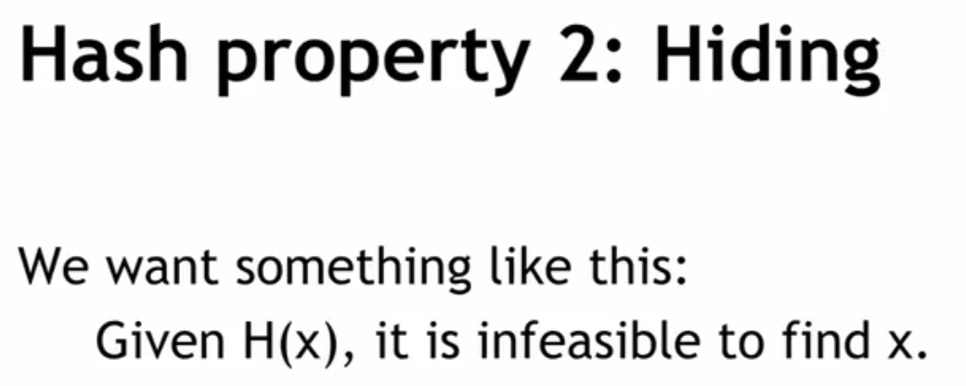
FAST-NUCES

Slide 9
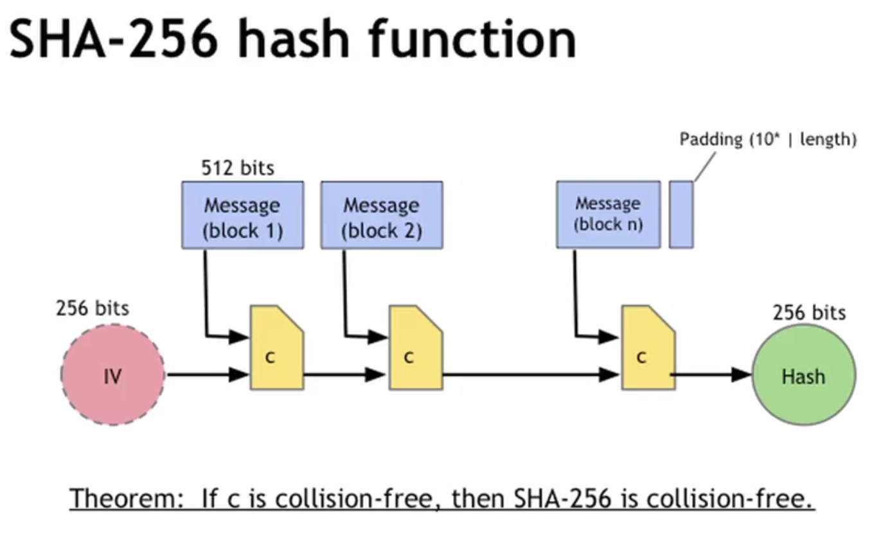
FAST-NUCES

Slide 10
Public Key Cryptography
FAST-NUCES

Slide 11
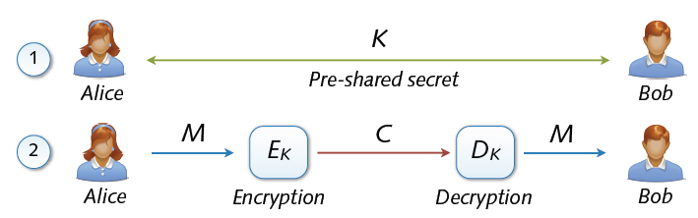
Symmetric cryptosystems
Precondition: secure exchange of keys in advance
Paradox situation at a first glance
secure communication depends on secure key exchange
FAST-NUCES

Slide 12
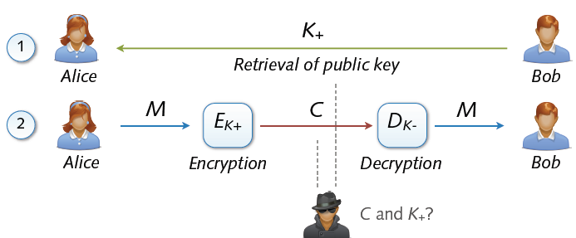
Asymmetric Cryptosystem
Asymmetric cryptosystems
Asymmetric encryption and decryption
K+ (pk) = public key of Bob K– (sk) = secret key of Bob
No secure key exchange necessary
FAST-NUCES

Slide 13
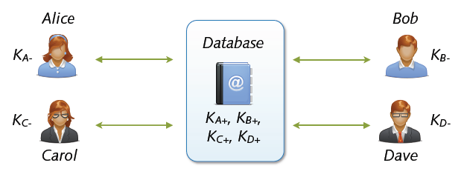
Key Exchange with Public Keys
Scalable communication with multiple parties
Linear number of exchanges: n parties → n public keys
Real-world systems with millions of keys (e.g. PGP)
... for the moment everything is fine
FAST-NUCES

Slide 14
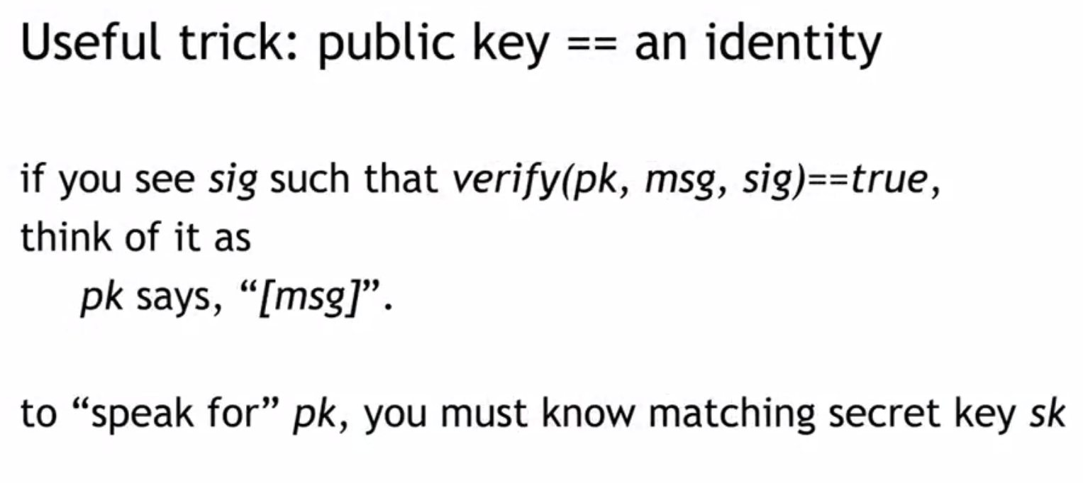
FAST-NUCES

Slide 15
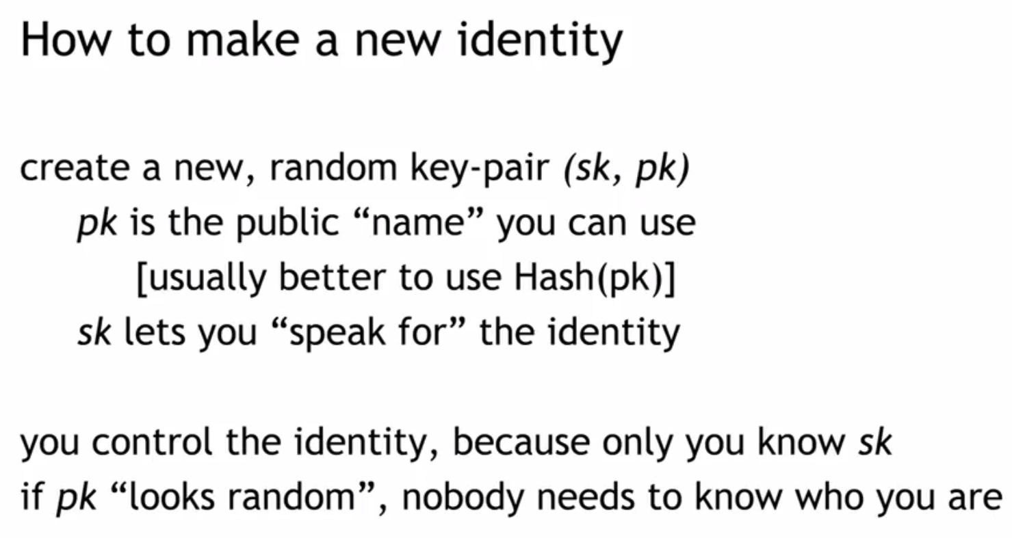
FAST-NUCES

Slide 16
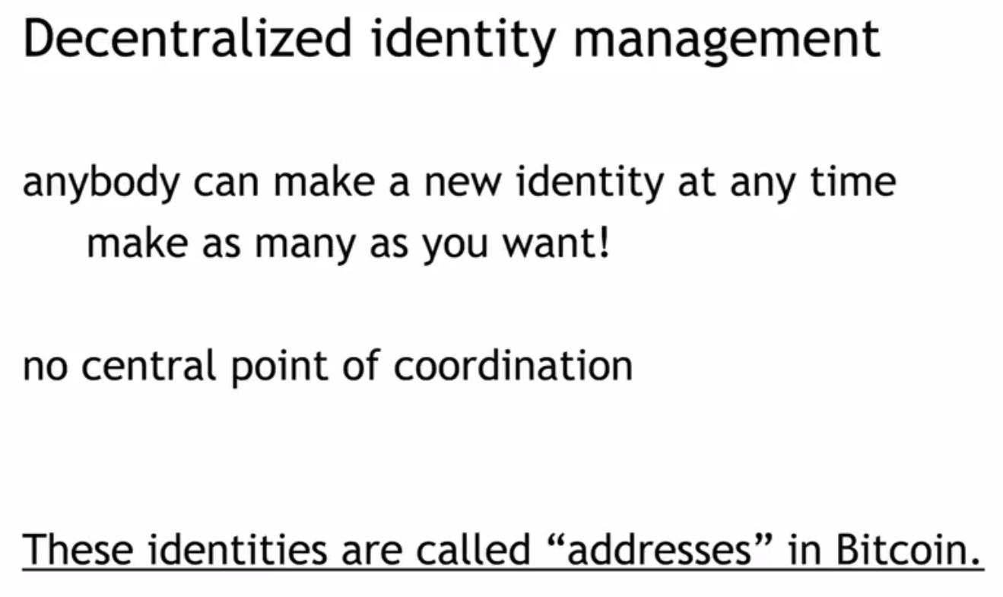
FAST-NUCES

Slide 17
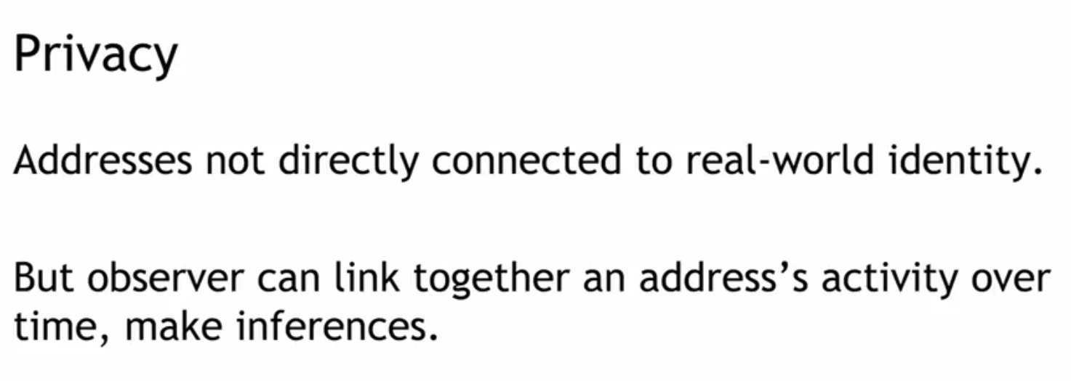
FAST-NUCES

Slide 18
Digital Signatures
FAST-NUCES

Slide 19
Digital Signature
Authentication and Non-Repudiation
Gives a recipient reason to believe that the message was created by a known sender such that they cannot deny sending it
Integrity
The message was not altered in transit
FAST-NUCES
Notes:
Non-repudiation refers to a state of affairs where the purported maker of a statement will not be able to successfully challenge the validity of the statement or contract
<number>

Slide 20
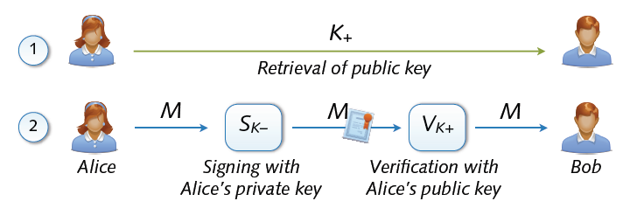
Digital Signature
Digital signing: reverse application of public-key system
Signing = encryption with private key
Verification = decryption with public key
FAST-NUCES

Slide 21
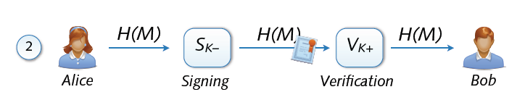
Signing and Hashing
Encryption and decryption of large messages inefficient
Signing of hash H(M) instead of message M
Verification of message M using signed hash H(M)
One-way property: hard to find M’ with H(M’) = H(M)
Support for signing emails, images, videos, ...
FAST-NUCES

Slide 22
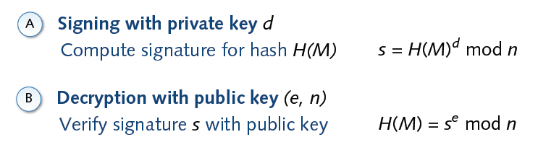
Signature and RSA
FAST-NUCES

Slide 23
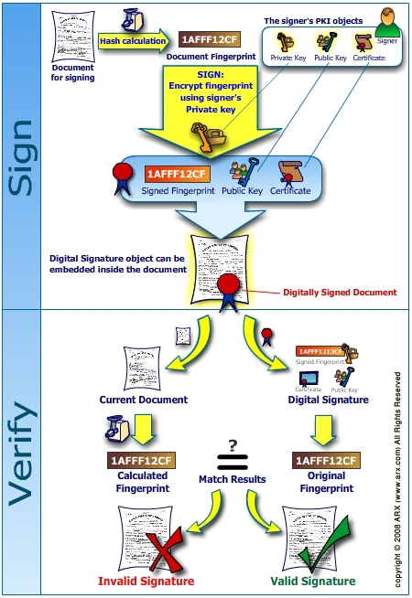
`
FAST-NUCES

Slide 24
Hash Pointer and Data Structures
FAST-NUCES

Slide 25
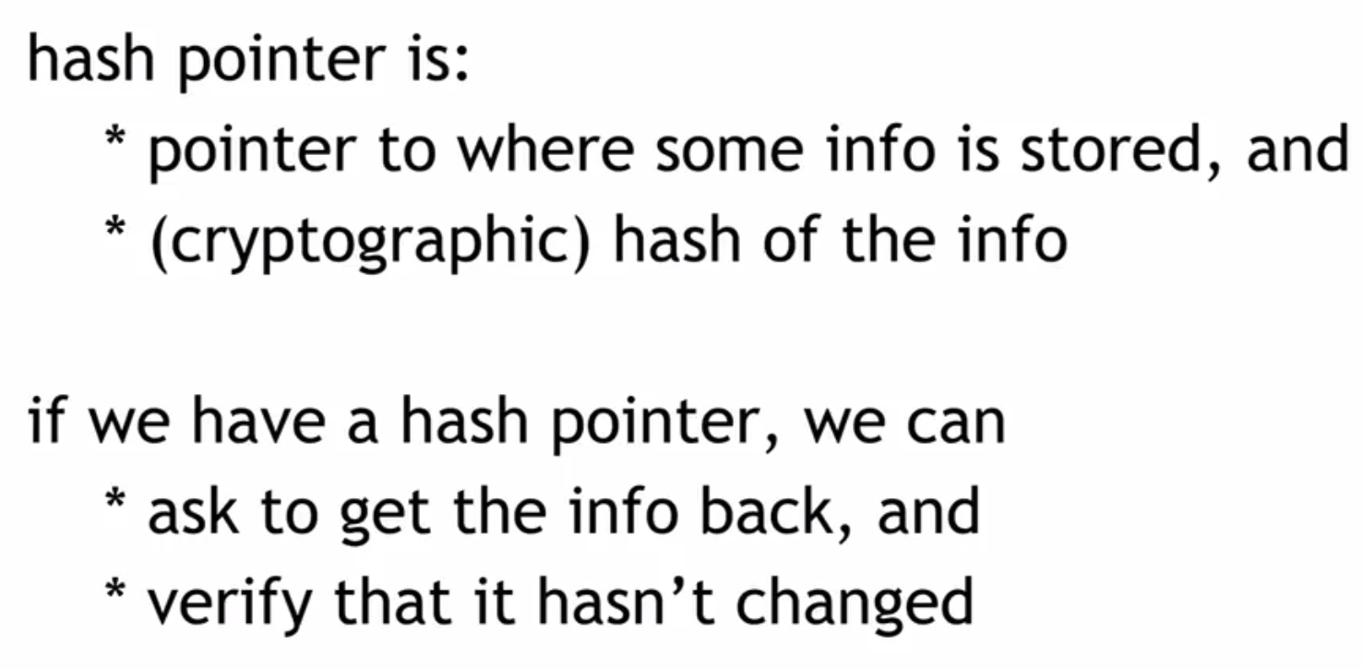
FAST-NUCES

Slide 26
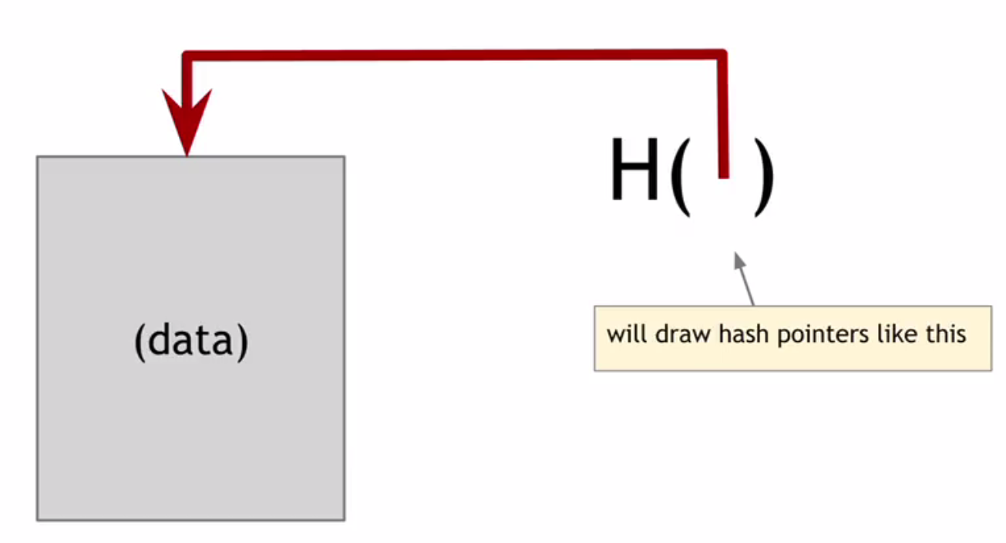
FAST-NUCES

Slide 27
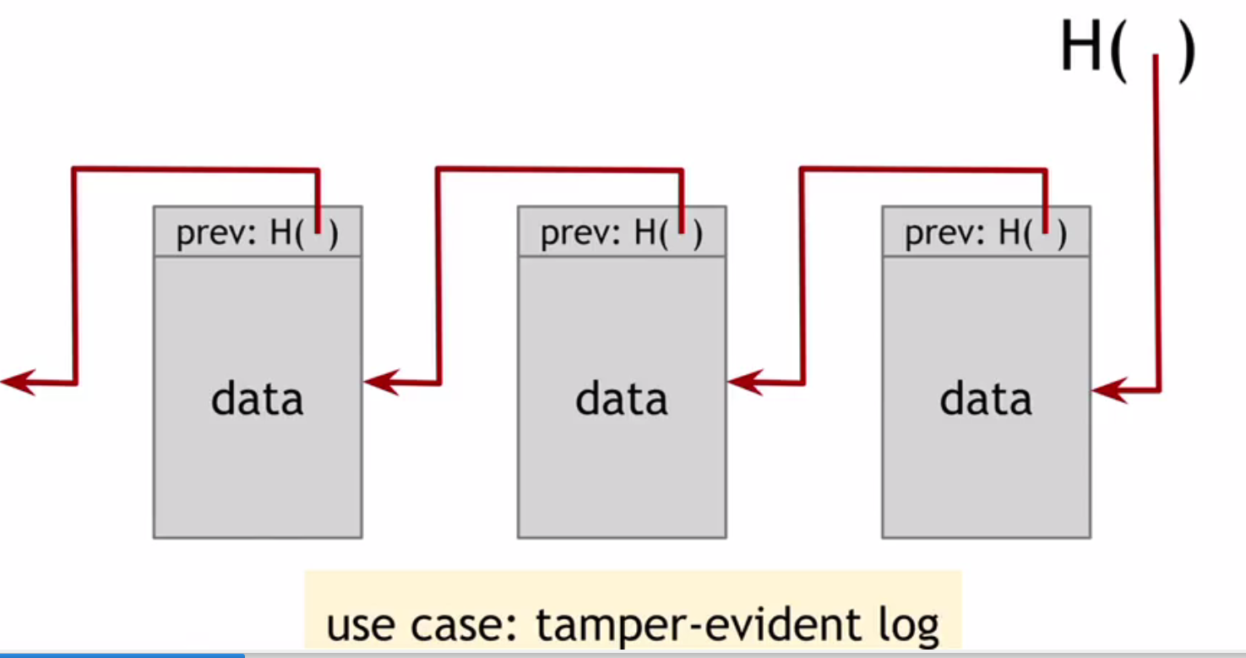
FAST-NUCES

Slide 28
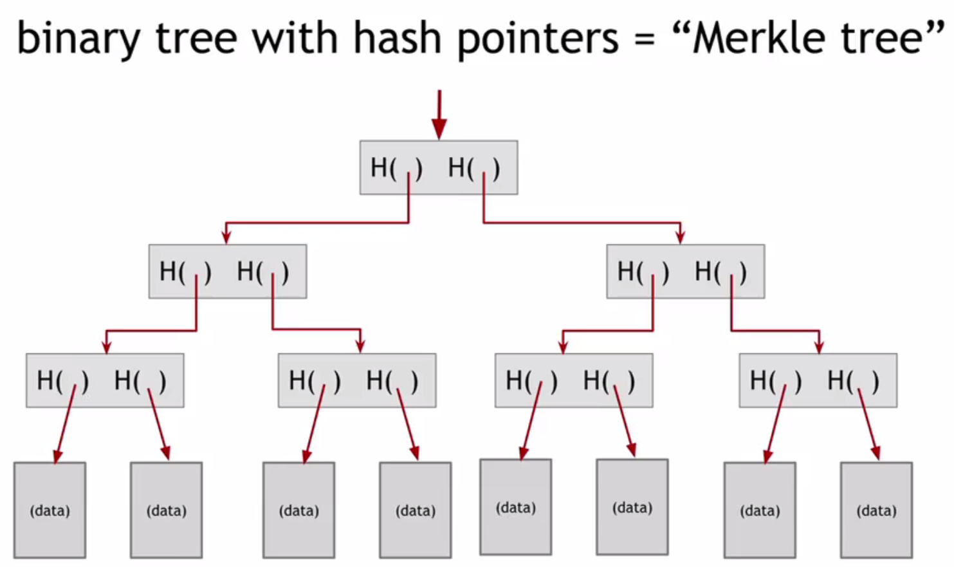
FAST-NUCES

Slide 29
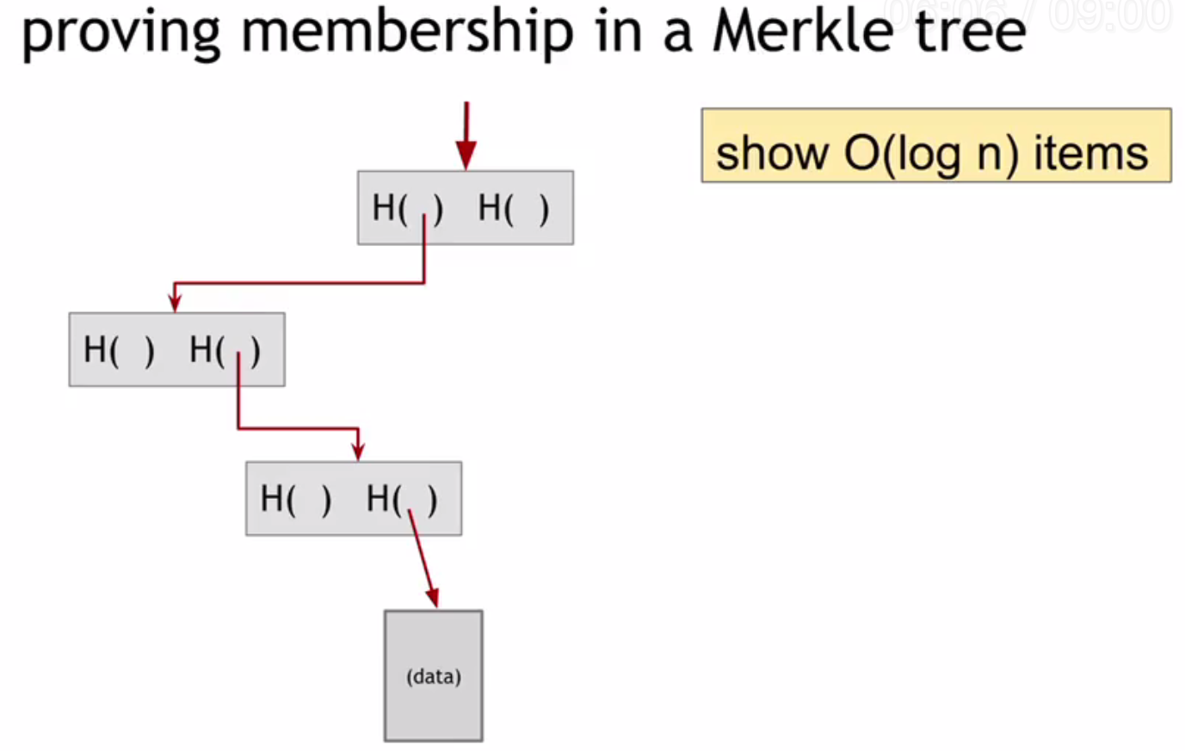
FAST-NUCES

Slide 30
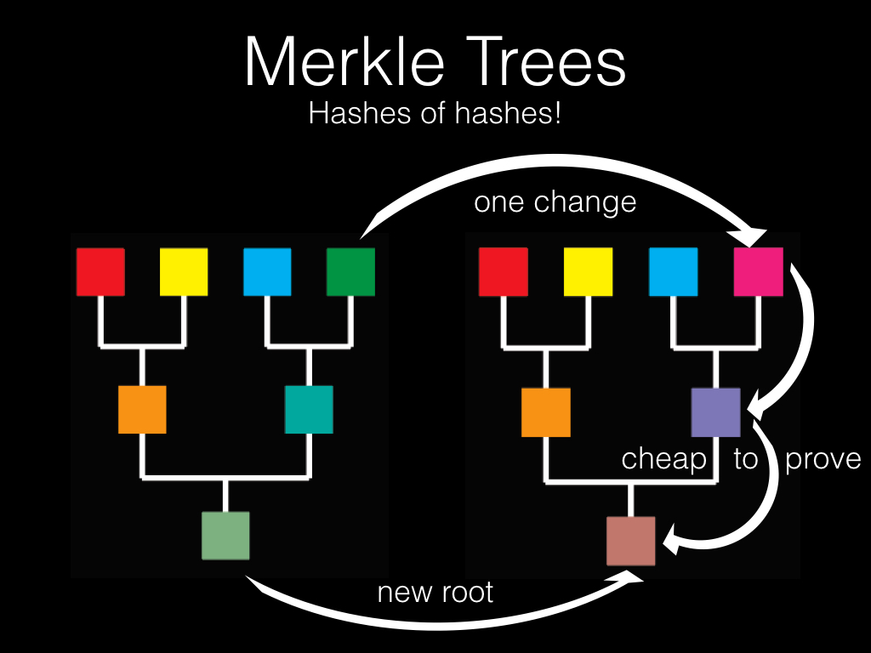
FAST-NUCES

Slide 31
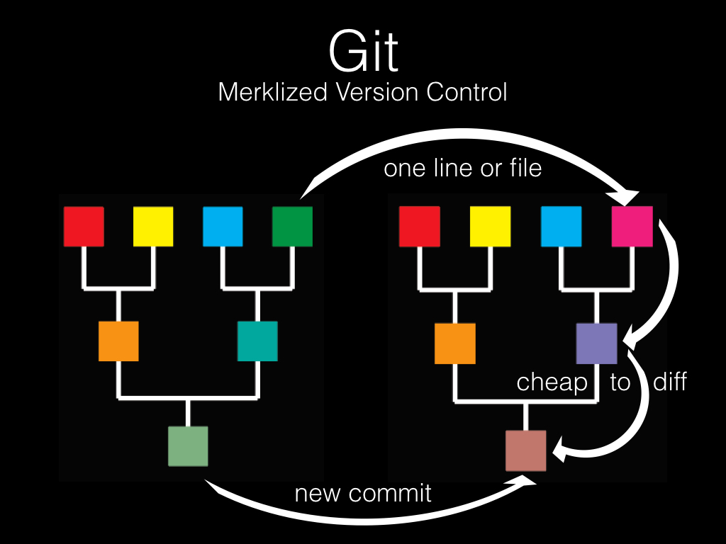
FAST-NUCES

Slide 32
Block Structure and BlockChains
FAST-NUCES

Slide 33
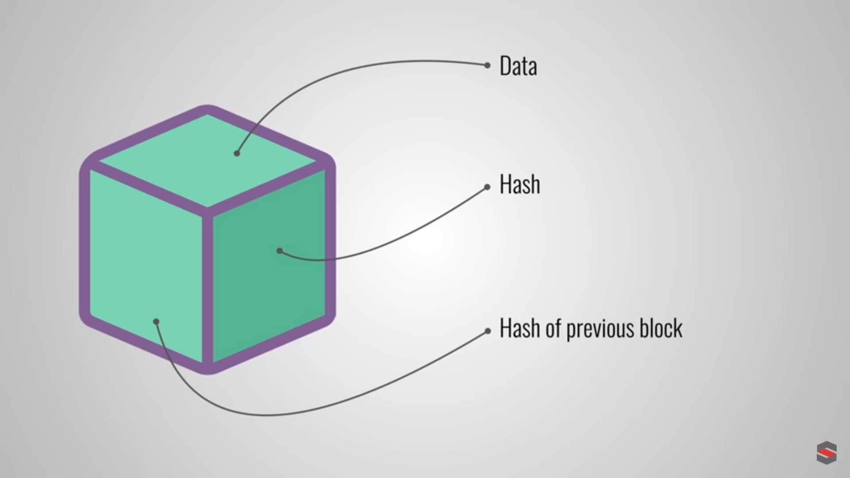
FAST-NUCES

Slide 34
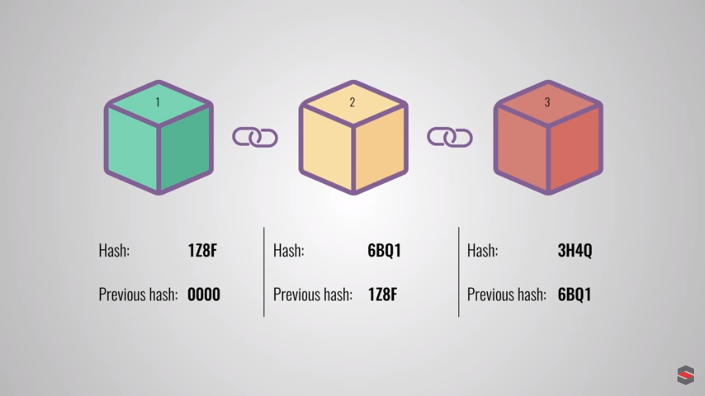
FAST-NUCES

Slide 35
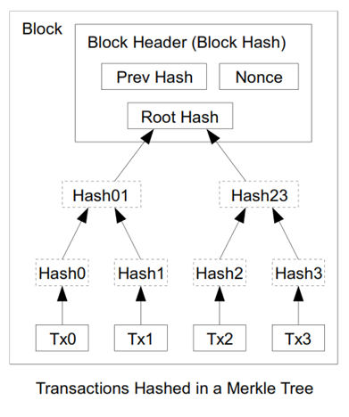
FAST-NUCES

Slide 36
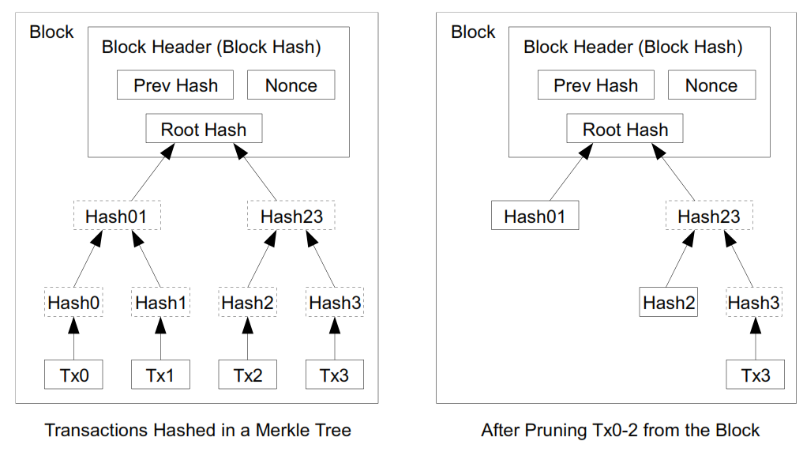
The spent transactions before it can be discarded to save disk space.
A block header with no transactions would be about 80 bytes. If we suppose blocks are generated every 10 minutes, 80 bytes * 6 * 24 * 365 = 4.2MB per year [Theoratically]
FAST-NUCES

Slide 37
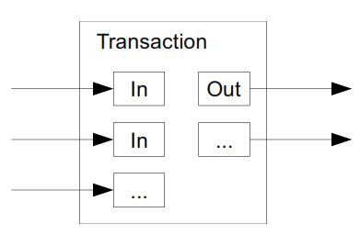
FAST-NUCES

Slide 38
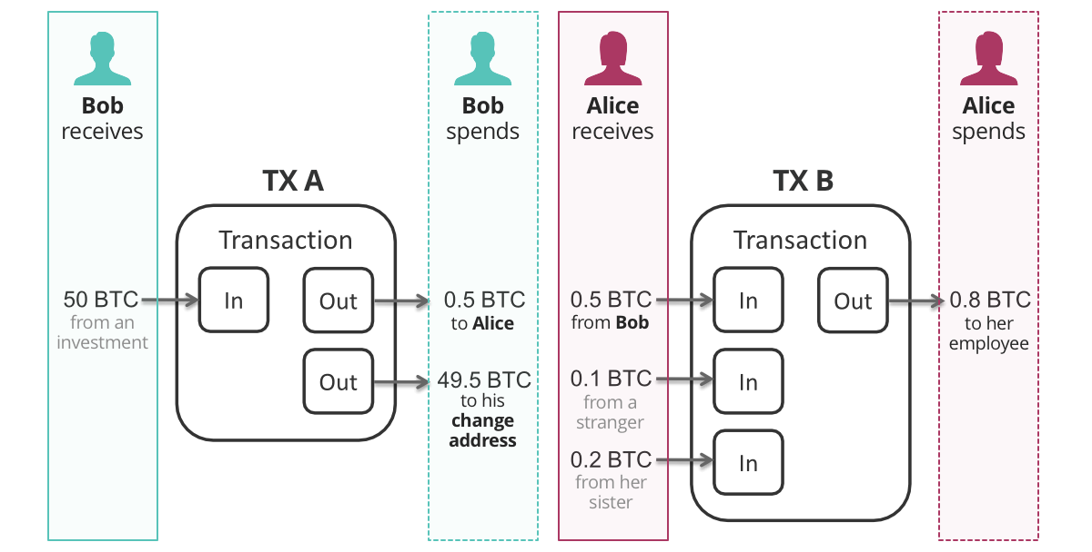
FAST-NUCES

Slide 39
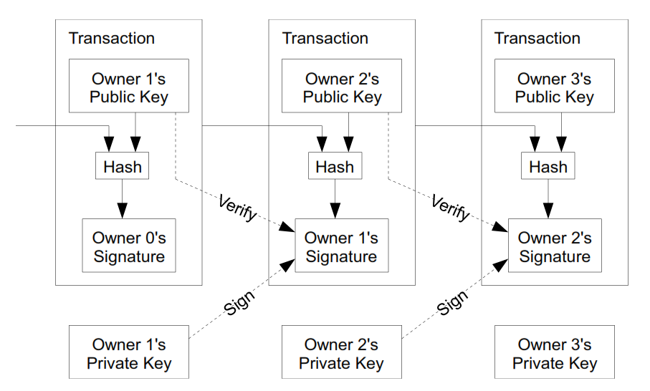
FAST-NUCES

Slide 40
Acknowledgements
Material in this lecture are taken from the slides prepared by:
Prof. Dr. Konrad Rieck (Uni-Göttingen)
Satoshi Nakamoto, Bitcoin: A Peer-to-Peer Electronic Cash System, 2008
https://twitter.com/savjee
Dan Finlay https://github.com/MetaMask/IPFS-Ethereum-Hackathon
Edureka.com
Prof. Arvind Narayanan — Princeton University
FAST-NUCES

